Slide 1
History of Linux
Dr. Deepamala. N
Associate Professor
RV College of Engineering

Slide 2



In mid 1960
The history of Unix dates back to the mid-1960s when the Massachusetts Institute of Technology, AT&T Bell Labs, and General Electric were jointly developing an experimental time-sharing operating system called Multiplexed Information and Computing Service(Multics) for the GE-645 mainframe.
Bell labs pulled out of project and wrote a smaller OS.
Ken Thompson wrote first version of Unix called UNICS.
In 1977, Bell Labs released Unix System III in 1982, AT&T released System V.
Ken Thompson and Dennis Ritchie, wrote Unix kernel in C in 1973.

Slide 3

Berkeley Software Distribution (BSD) – 1977-1995
One of the biggest contributors were University of California at Berkeley. . Variants of Unix from Berkeley are known as Berkeley Software Distributions, or BSD. Berkeley’s first release,
1BSD in 1977, was a collection of patches and additional software on top of Bell Labs’ Unix.
2BSD in 1978 continued this trend, adding the csh and vi utilities, which persist on Unix systems to this day.
The first standalone Berkeley Unix was 3BSD in 1979. It added virtual memory (VM) to an already impressive list of features.
A series of 4BSD releases, 4.0BSD, 4.1BSD, 4.2BSD, 4.3BSD, followed 3BSD.These versions of Unix added job control, demand paging, and TCP/IP.
In 1994, the university released the final official Berkeley Unix, featuring a rewritten VM subsystem, as 4.4BSD

Slide 4

1980s and 1990s
Multiple workstation and server companies introduced their own commercial versions of Unix
These systems were based on either an AT&T or a Berkeley release and supported high-end features developed for their particular hardware architecture.
Among these systems were Digital’s Tru64, Hewlett Packard’s HP-UX, IBM’s AIX, Sequent’s DYNIX/ptx, SGI’s IRIX, and Sun’s Solaris & SunOS.
Linux Torvalds released Linux in 1991.
Watch: AT&T Archives: The UNIX Operating System - YouTube

Slide 5
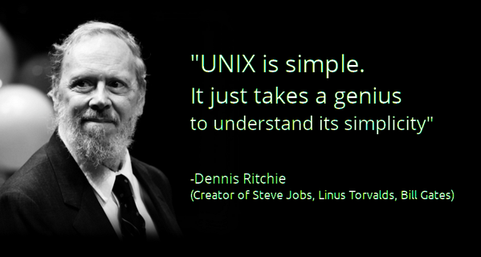
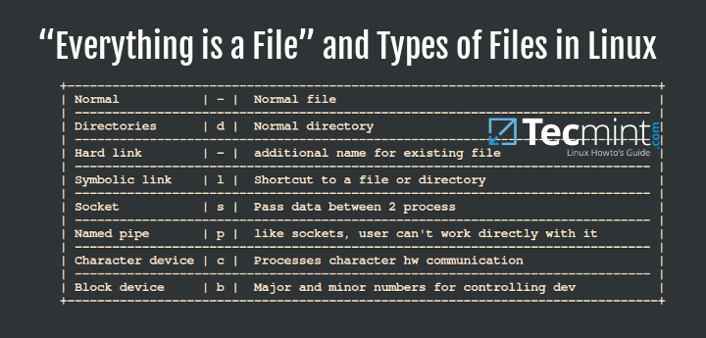

Features of Unix
1. Unix is simple - Unix systems implement only hundreds of system calls and have a straightforward, even basic, design.
2. Unix, everything is a file - This simplifies the manipulation of data and devices into a set of core system calls: open(), read(), write(), lseek(), and close().
3. Linux kernel and utilities are written in C
4. Unix has fast process creation time and the unique fork() system call.
5. Unix provides simple yet robust inter process communication (IPC) primitives that, when coupled with the fast process creation time, enable the creation of simple programs that do one thing and do it well.

Slide 6

Along came Linux
Linus Torvalds developed the first version of Linux in 1991 as an operating system for computers powered by the Intel.
Linux is a Unix-like system, but it is not Unix
The Linux kernel, as with much of the system, is free or open source software
Linux kernel is licensed under the GNU General Public License (GPL) version 2.0.

Slide 7
Overview of Operating Systems and Kernels
Kernel is referred to as Supervisor, Core or internals
The Linux kernel code runs in Kernel Space and User program runs in user space.
Program switches back and forth to the kernel called “Context switch”

Slide 8
Question? Try: time find /home
main()
{
char str[100];
scanf(“%s”,str);
printf(“%s”,str);
}
How many times control switches from user space to kernel space and back to user space?

Slide 9
Question? Ans: 2 times Try: time find /home
main()
{
char str[100];
scanf(“%s”,str);
printf(“%s”,str);
}
How many times control switches from user space to kernel space and back to user space?

Slide 10
Question? Try: time find /home
main()
{
char str1[100], str2[100];
scanf(“%s”,str1);
strcpy(str2,str1);
printf(“%s”,str2);
}
How many times control switches from user space to kernel space and back to user space?

Slide 11
Process Context
Process Context
Applications running on the system communicate with the kernel via system calls.
When an application executes a system call, we say that the kernel is executing on behalf of the application.
Furthermore, the application is said to be executing a system call in kernel-space, and the kernel is running in process context.

Slide 12

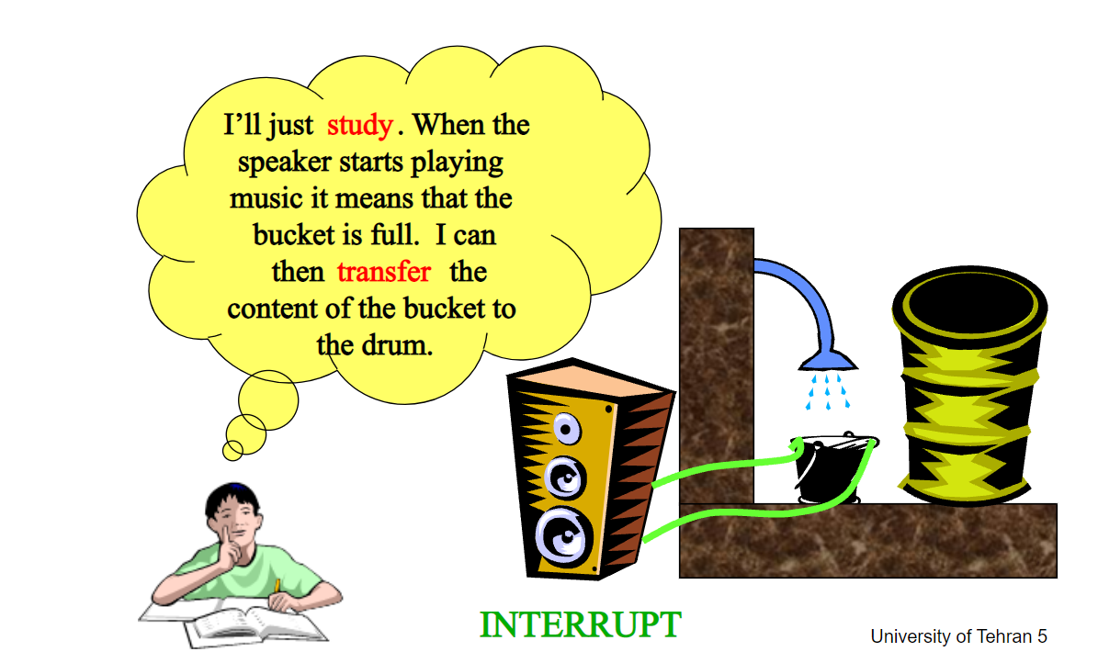
Interrupt Context
The kernel also manages the system’s hardware. Nearly all architectures, including all systems that Linux supports, provide the concept of interrupts
A number identifies interrupts and the kernel uses this number to execute a specific interrupt handler to process and respond to the interrupt.
In many operating systems, including Linux, the interrupt handlers do not run in a process context. Instead, they run in a special interrupt context that is not associated with any process.
Polling Vs Interrupts

Slide 13
Linux Versus Classic Unix Kernels Monolithic Vs Microkernel Designs
Microkernels, on the other hand, are not implemented as a single large process. Instead, the functionality of the kernel is broken down into separate processes, usually called servers.
Ideally, only the servers absolutely requiring such capabilities run in a privileged execution mode. The rest of the servers run in user-space.
All the servers, though, are separated into different address spaces. Therefore, direct function invocation as in monolithic kernels is not possible.
Instead, microkernels communicate via message passing: An interprocess communication (IPC) mechanism is built into the system, and the various servers communicate with and invoke “services” from each other by sending messages over the IPC mechanism.
The separation of the various servers prevents a failure in one server from bringing down another. Likewise, the modularity of the system enables one server to be swapped out for another.
The Windows NT kernel (on which Windows XP, Vista, and 7 are based) and Mach (on which part of Mac OS X is based) are examples of microkernels
Monolithic kernels are the simpler design of the two, and all kernels were designed in this manner until the 1980s.
Monolithic kernels are implemented entirely as a single process running in a single address space. Consequently, such kernels typically exist on disk as single static binaries.
All kernel services exist and execute in the large kernel address space.
Communication within the kernel is trivial because everything runs in kernel mode in the same address space: The kernel can invoke functions directly, as a user-space application might.
Proponents of this model cite the simplicity and performance of the monolithic approach. Most Unix systems are monolithic in design.
Linux is a monolithic kernel. , Linux is modular, threaded, and the kernel itself is schedulable.
Eg: MS-Dos, Unix, Linux

Slide 14
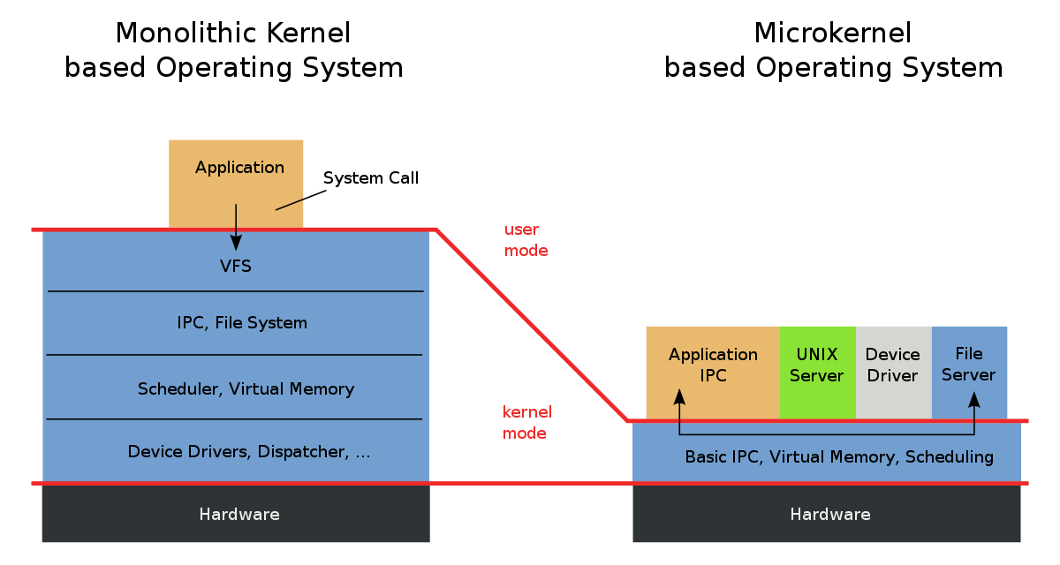

Slide 15
Difference between Linux and Unix Kernel
Linux supports the dynamic loading of kernel modules. Although the Linux kernel is monolithic, it can dynamically load and unload kernel code on demand.
Linux has symmetrical multiprocessor (SMP) support. Although most commercial variants of Unix now support SMP, most traditional Unix implementations did not.
The Linux kernel is preemptive. Unlike traditional Unix variants, the Linux kernel can preempt a task even as it executes in the kernel. Of the other commercial Unix implementations, Solaris and IRIX have preemptive kernels, but most Unix kernels are not preemptive.
Linux takes an interesting approach to thread support: It does not differentiate between threads and normal processes. To the kernel, all processes are the same— some just happen to share resources.
Linux provides an object-oriented device model with device classes, hot-pluggable events, and a user-space device filesystem (sysfs).
Linux ignores some common Unix features that the kernel developers consider poorly designed, such as STREAMS, or standards that are impossible to cleanly implement.
Linux is free in every sense of the word. The feature set Linux implements is the result of the freedom of Linux’s open development model. If a feature is without merit or poorly thought out, Linux developers are under no obligation to implement it. To the contrary, Linux has adopted an elitist attitude toward changes: Modifications must solve a specific real-world problem, derive from a clean design, and have a solid implementation. Consequently, features of some other modern Unix variants that are more marketing bullet or one-off requests, such as pageable kernel memory, have received no consideration.

Slide 16
Lets write a kernel Code (Extra Information)
Linux supports the dynamic loading of kernel modules. Although the Linux kernel is monolithic, it can dynamically load and unload kernel code on demand.
In the Linux kernel there are 2 different modules:
Static Modules 2. Dynamic Modules.
Static modules are those which are compiled as part of the base kernel and it is available at any time.
Dynamic Modules are compiled as modules separately and loaded based on user demand. These are also called as Loadable Kernel Modules(LKM)
In LKM there are two different ways to load the kernel modules.
Insmod : (To load a module into the kernel).
modprobe : (To detect any dependent module required) and load it.
: To remove a module from kernel.
dmrmmodesg: Command which is used to display the kernel-related messages.
Different types of Linux kernel Modules | by Santhosh Kgn | Medium

Slide 17
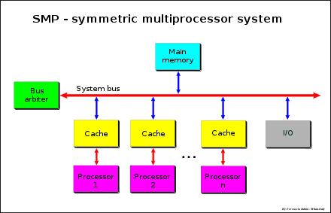
Symmetric multiprocessing or shared-memory multiprocessing (Extra Information)
Linux has symmetrical multiprocessor (SMP) support. Although most commercial variants of Unix now support SMP, most traditional Unix implementations did not.
Symmetrical multiprocessing (SMP) denotes a multiprocessor architecture in which no CPU is selected as the Master CPU, but rather all of them cooperate on an equal basis, hence the name "symmetrical."

Slide 18
Sysfs (Extra Information)
Linux provides an object-oriented device model with device classes, hot-pluggable events, and a user-space device filesystem (sysfs).
Sysfs is a virtual level file system which is having the information about the devices and drivers and is used for exporting system level information from kernel space to the user space for the particular device you connect.
Eg: /sys/classes
Cat /sys/classes/net/enp0s3/address

Slide 19
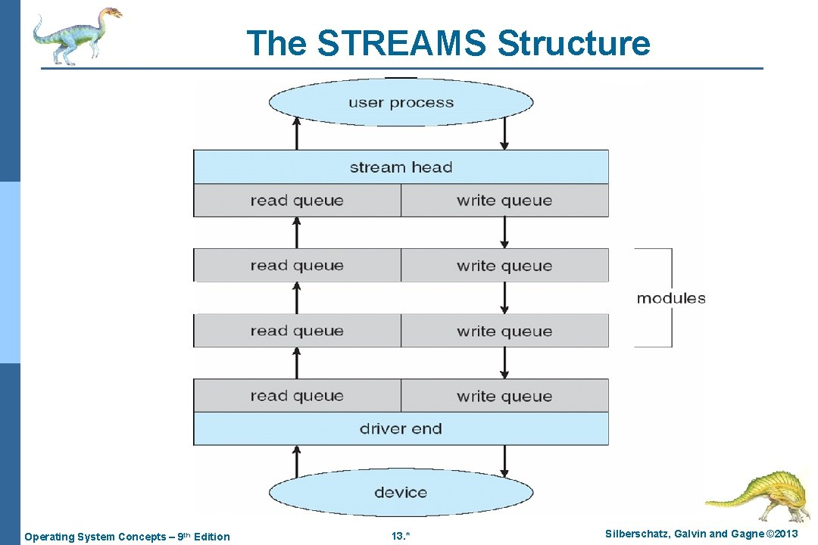
Streams (Extra Information)
A stream is a full-duplex connection between a device driver and a user-level process.
It consists of
a stream head that interfaces with the user process
a driver end that controls the device,
and zero or more stream modules between them.

Slide 20
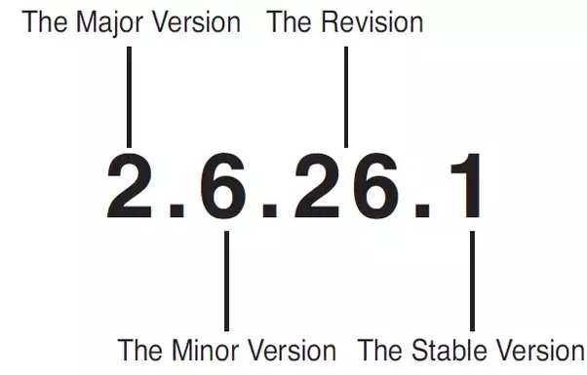
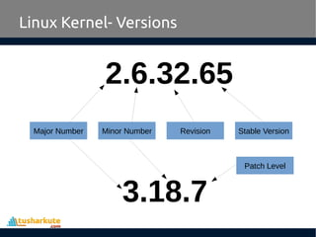
Linux Kernel Versions
Kernel Versions come in 2 flavors: Stable and Development
The minor release also determines whether the kernel is a stable or development kernel; an even number is stable, whereas an odd number is development.
Stable release represent crucial bug fixes
Third number if release number (Even- stable, Odd- development) – mostly bug fixes
The first two values represent the series. Eg: 2.6 kernel series. Latest is __________________

Slide 21
